Slide 1

Student Details
Name: Shruti Kayarkar
SkillsBuild Email Id: shrutikayarkar9@gmail.com
College Name: St. Vincent Pallotti College of Engineering and Technology
College State: Maharashtra
Internship Domain and Internship Start and End date: [Data Analytics] [12/06/2023 – 24/07/2023]

Slide 2
PROJECT TITLE/Problem Statement
PROJECT TITLE: ANALYSIS OF SUPERSTORE DATASET
PROBLEM STATEMENT: The problem at hand is to perform a comprehensive analysis of a Superstore dataset. The Superstore dataset contains information about various aspects of the store's operations, such as sales, profits, customer demographics, product categories, and shipping details. The goal of this analysis is to extract valuable insights and provide actionable recommendations to optimize the store's performance and profitability.

Slide 3
AGENDA
Data Exploration and Understanding
Sales Analysis
Profit Analysis
Customer Analysis
Inventory Analysis
Operational Efficiency Analysis
Data Visualization and Reporting

Slide 4
PROJECT OVERVIEW
The analysis of the Superstore dataset project aims to extract valuable insights and provide actionable recommendations to optimize the performance and profitability of a retail Superstore. The project involves conducting a comprehensive analysis of various aspects of the Superstore's operations, including sales, profits, customer demographics, product categories, and shipping details. By analyzing the dataset, the project aims to understand trends, patterns, and relationships within the data, which can then be used to make informed business decisions.
The project can be divided into several key stages:
Data Collection
Data Cleaning and Preparation
Data Exploration and Visualization
Sales Analysis
Profit Analysis
Customer Analysis
Inventory Analysis
Operational Efficiency Analysis
Reporting and Recommendations

Slide 5
WHO ARE THE END USERS of this project?
The end users of the analysis of the Superstore dataset project can vary depending on the organization and its structure. However, some common end users of the analysis may include:
Management Team
Operations Team
Marketing Team
Sales Team
Finance Team
Customer Service Team
Business Analysts and Data Scientists

Slide 6
YOUR SOLUTION AND ITS VALUE PROPOSITION
The solution of the analysis of the Superstore dataset project lies in the extraction of valuable insights and the generation of actionable recommendations for the Superstore. By leveraging the power of data analysis, the project aims to optimize the store's performance and profitability, improve operational efficiency, enhance customer satisfaction, and drive strategic decision-making. The value proposition of the project can be summarized as follows:
Data-driven Decision Making
Increased Profitability
Enhanced Sales Strategies
Improved Customer Engagement
Optimized Inventory Management
Streamlined Operations
Strategic Planning and Growth

Slide 7
How did you customize the project and make it your own
To customize the analysis of the Superstore dataset project and make it our own, can consider the following steps:
Define Specific Objectives
Select Relevant Variables
Refine Analysis Approaches
Incorporate External Data Sources
Incorporate Business Context
Customize Reporting and Recommendations
Iterate and Improve

Slide 8
MODELLING
Here's an outline of a modeling approach:
Data Exploration and Descriptive Statistics
Sales Analysis
Profit Analysis
Customer Analysis
Inventory Analysis
Operational Efficiency Analysis
Data Visualization and Reporting

Slide 9
Results
The analysis of the Superstore dataset project can yield various results and insights depending on the specific goals and questions being addressed. Here are some potential outcomes and findings that could arise from analyzing the Superstore dataset:
Sales Trends
Product Performance
Customer Segmentation
Profitability Analysis
Inventory Management
Order Fulfillment Analysis
Sales Channel Analysis
Forecasting and Predictive Analytics
Data Visualization and Reporting

Slide 10
links
GITHUB LINK
https://github.com/shrutikayarkar0710/Analysis-of-Superstore-Dataset.git
RESEARCH PAPERS
https://www.kaggle.com/datasets/saurabh00007/iriscsv?resource=download
https://www.analyticsvidhya.com/blog/2022/03/eda-on-superstore-dataset-using-python/
https://powerbi.microsoft.com/en-us/tutorials/analyze-and-visualize-superstore-data/

Slide 11
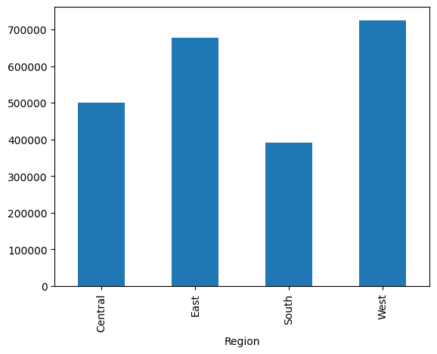
SALES ANALYSIS BASED ON REGION df.groupby("region")["sales"].sum().plot.bar()
The code groups the data by region, calculates the total sales for each region, and then creates a bar plot to display the summed sales values for each region. This visualization helps compare the sales performance across different regions in the dataset.

Slide 12
PROFIT ANALYSIS BASED ON REGION df.groupby("region")["sales"].sum().plot.bar()
The code groups the data by region, calculates the total sales for each region, and then creates a bar plot to display the summed sales values for each region. This visualization helps compare the sales performance across different regions in the dataset, similar to the previous code snippet. The only difference is that the column names "Region" and "Sales" are used instead of "region" and "sales" respectively.

Slide 13
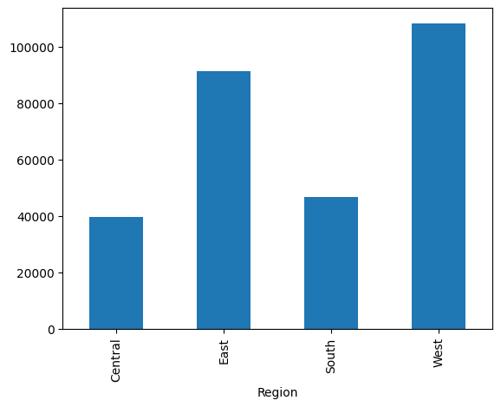
df.groupby("region")["profit"].sum().plot.bar()
The code groups the data by region, calculates the total profit for each region, and then creates a bar plot to display the summed profit values for each region. This visualization helps compare the profitability across different regions in the dataset.

Slide 14
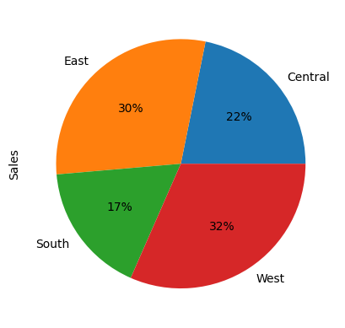
df.groupby("region")["sales"].sum().plot.pie(autopct="%1.0f%%")
The code groups the data by region, calculates the total sales for each region, and then creates a pie chart to visualize the distribution of sales across different regions. The pie chart shows the proportion of sales contributed by each region, allowing for easy comparison of sales distribution. The ‘autopct’ parameter formats the percentage labels on the chart.

Slide 15
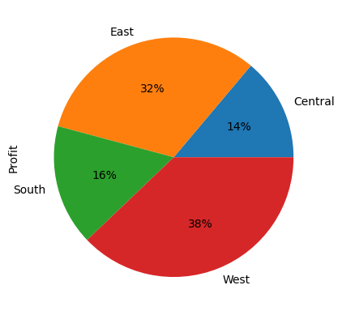
df.groupby("region")["profit"].sum().plot.pie(autopct="%1.0f%%")
The code groups the data by region, calculates the total profit for each region, and then creates a pie chart to visualize the distribution of profits across different regions. The pie chart shows the proportion of profits contributed by each region, allowing for easy comparison of profit distribution. The ‘autopct’ parameter formats the percentage labels on the chart.

Slide 16
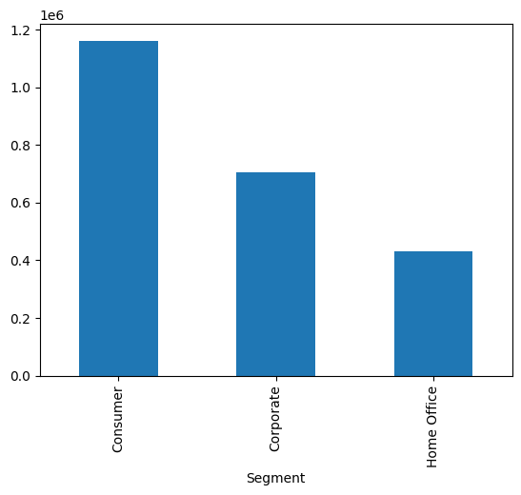
df.groupby("segment")["sales"].sum().plot.bar()
The code groups the data by segment, calculates the total sales for each segment, and then creates a bar plot to display the summed sales values for each segment. This visualization helps compare the sales performance across different segments in the dataset. Each segment will have a corresponding bar, and the height of each bar represents the total sales for that segment.

Slide 17
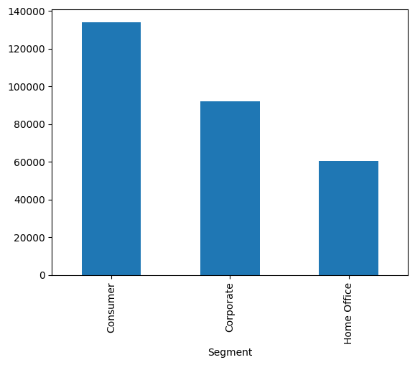
df.groupby("segment")["profit"].sum().plot.bar()
The code groups the data by segment, calculates the total profit for each segment, and then creates a bar plot to display the summed profit values for each segment. This visualization helps compare the profitability across different segments in the dataset. Each segment will have a corresponding bar, and the height of each bar represents the total profit for that segment.

Slide 18
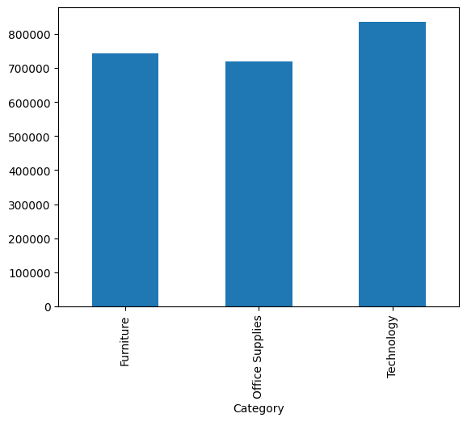
df.groupby("category")["sales"].sum().plot.bar()
The code groups the data by category, calculates the total sales for each category, and then creates a bar plot to display the summed sales values for each category. This visualization helps compare the sales performance across different categories in the dataset. Each category will have a corresponding bar, and the height of each bar represents the total sales for that category.

Slide 19
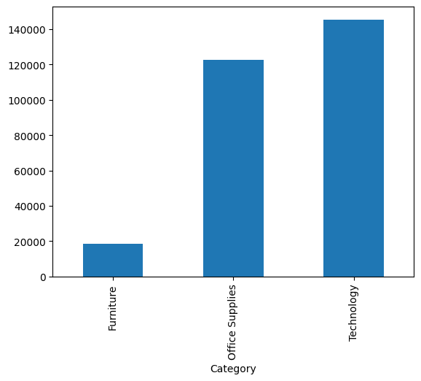
df.groupby("category")["profit"].sum().plot.bar()
The code groups the data by category, calculates the total profit for each category, and then creates a bar plot to display the summed profit values for each category. This visualization helps compare the profitability across different categories in the dataset. Each category will have a corresponding bar, and the height of each bar represents the total profit for that category.

Slide 20
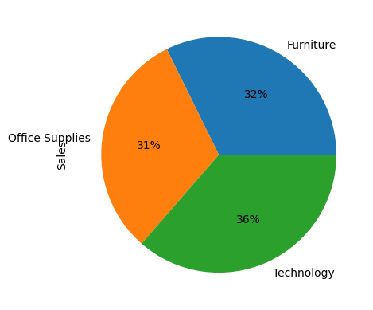
df.groupby("category")["sales"].sum().plot.pie(autopct="%1.0f%%")
The code groups the data by category, calculates the total sales for each category, and then creates a pie chart to visualize the distribution of sales across different categories. The pie chart shows the proportion of sales contributed by each category, allowing for easy comparison of sales distribution. The ‘autopct’ parameter formats the percentage labels on the chart.

Slide 21
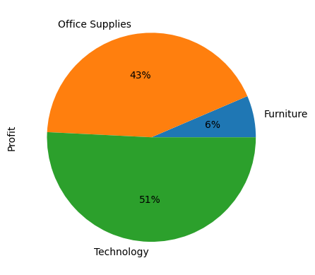
df.groupby("category")["profit"].sum().plot.pie(autopct="%1.0f%%")
The code groups the data by category, calculates the total profit for each category, and then creates a pie chart to visualize the distribution of profits across different categories. The pie chart shows the proportion of profits contributed by each category, allowing for easy comparison of profit distribution. The ‘autopct’ parameter formats the percentage labels on the chart.

Slide 22
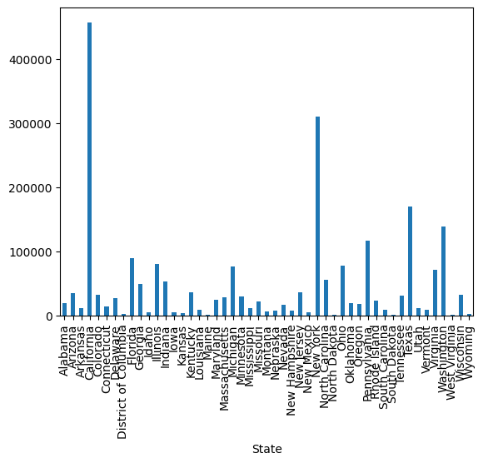
df.groupby("state")["sales"].sum().plot.bar()
The code groups the data by state, calculates the total sales for each state, and then creates a bar plot to display the summed sales values for each state. This visualization helps compare the sales performance across different states in the dataset. Each state will have a corresponding bar, and the height of each bar represents the total sales for that state.

Slide 23
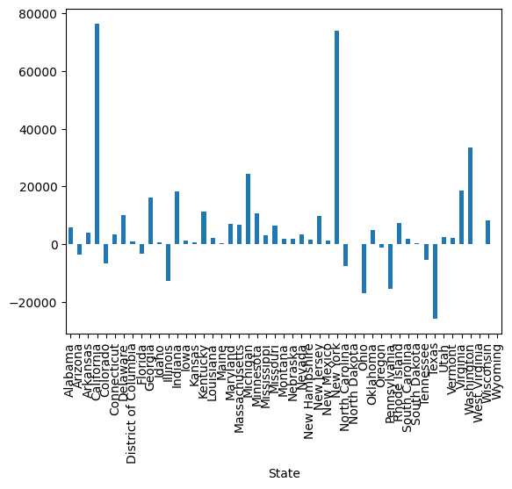
df.groupby("state")["profit"].sum().plot.bar()
The code groups the data by state, calculates the total profit for each state, and then creates a bar plot to display the summed profit values for each state. This visualization helps compare the profitability across different states in the dataset. Each state will have a corresponding bar, and the height of each bar represents the total profit for that state.

Slide 24
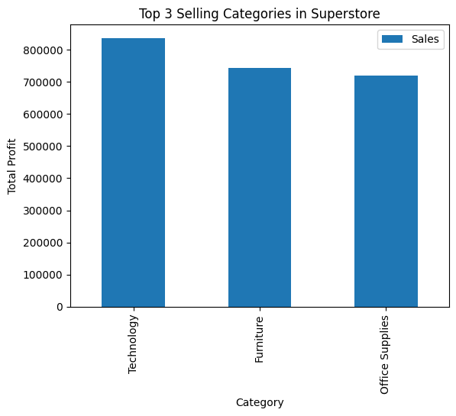
top_3_selling_categories.plot(kind = "bar") plt.title("top 3 selling categories in superstore") plt.xlabel("category") plt.ylabel("total profit") plt.show()
The code generates a bar plot to visualize the top 3 selling categories in the Superstore dataset. The x-axis represents the categories, the y-axis represents the total profit, and the bars represent the total profit values for each category. The plot is given a title, and the x and y axes are labeled accordingly. Finally, the plot is displayed on the screen using ‘plt.show()’.

Slide 25
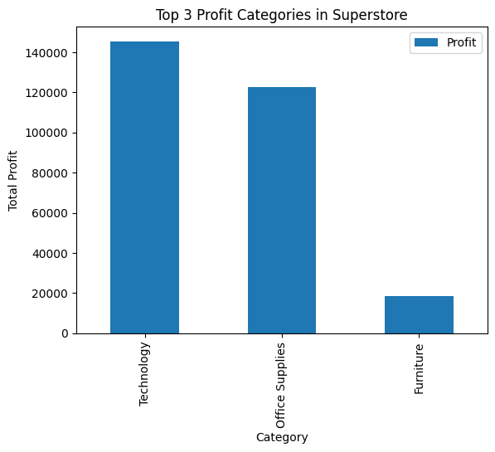
top_3_profit_categories.plot(kind="bar") plt.title("top 3 profit categories in superstore") plt.xlabel("category") plt.ylabel("total profit") plt.show()
The code generates a bar plot to visualize the top 3 profit categories in the Superstore dataset. The x-axis represents the categories, the y-axis represents the total profit, and the bars represent the total profit values for each category. The plot is given a title, and the x and y axes are labeled accordingly. Finally, the plot is displayed on the screen using ‘plt.show()’.

Slide 26
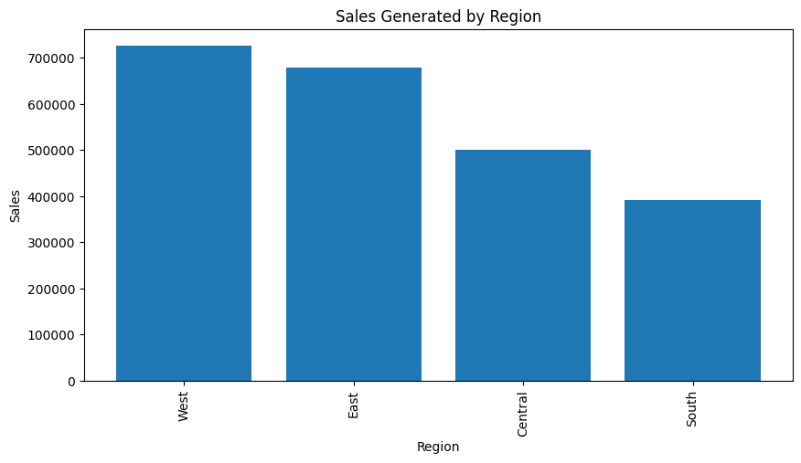
# group the data by region and city and calculate the total sales for each group region_sales = df_places.groupby(['region'], as_index=false).sum() region_sales.sort_values(by='sales', ascending=false, inplace=true) # plot the total sales geprofitnerated by each region and city plt.figure(figsize=(10,5)) plt.bar(region_sales['region'], region_sales['sales'], align='center',) plt.xlabel("region") plt.ylabel("sales") plt.title("sales generated by region") plt.xticks(rotation=90) plt.show() region_sales
The code groups the data by region, calculates the total sales for each region, sorts the results, and then creates a bar plot to visualize the sales generated by each region. The plot is labeled and displayed on the screen. The resulting DataFrame, ‘region_sales’, contains the summed sales values for each region.

Slide 27
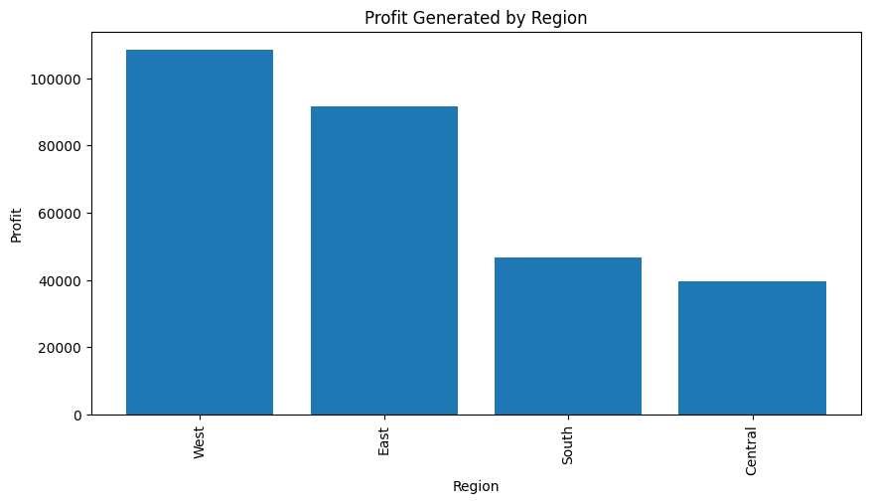
# group the data by region and city and calculate the total sales for each group region_profit = df_places.groupby(['region'], as_index=false).sum() region_profit.sort_values(by='profit', ascending=false, inplace=true) # plot the total sales generated by each region and city plt.figure(figsize=(10,5)) plt.bar(region_profit['region'], region_profit['profit'], align='center',) plt.xlabel("region") plt.ylabel("profit") plt.title("profit generated by region") plt.xticks(rotation=90) plt.show() region_profit
The code groups the data by region, calculates the total profits for each region, sorts the results, and then creates a bar plot to visualize the profits generated by each region. The plot is labeled and displayed on the screen. The resulting DataFrame, ‘region_profit’, contains the summed profit values for each region.

Slide 28
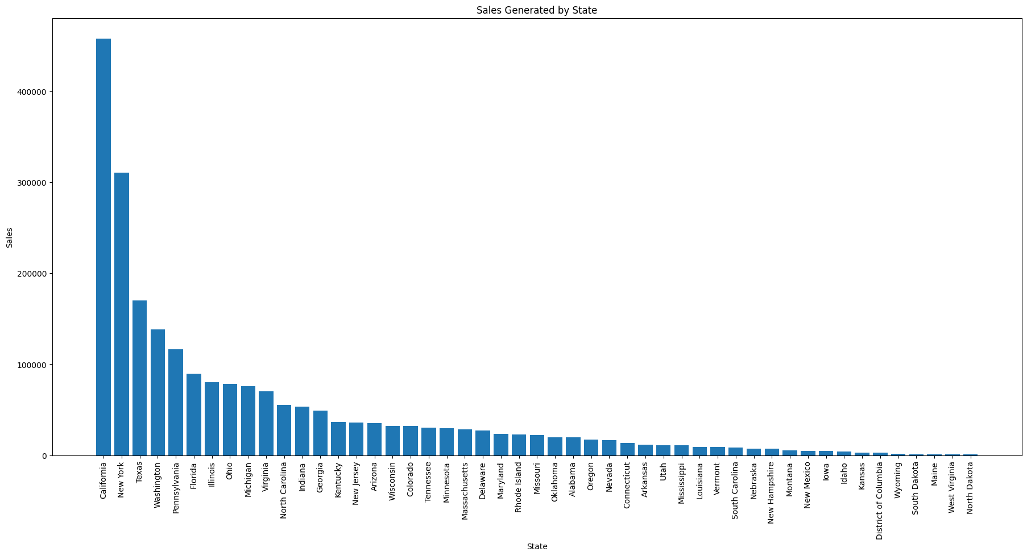
state_sales = df_places.groupby(['state'], as_index=false).sum() state_sales.sort_values(by='sales', ascending=false, inplace=true) plt.figure(figsize=(22,10)) plt.bar(state_sales['state'], state_sales['sales'], align='center',) plt.xlabel("state") plt.ylabel("sales") plt.title("sales generated by state") plt.xticks(rotation=90) plt.show() state_sales
The code groups the data by state, calculates the total sales for each state, sorts the results, and then creates a bar plot to visualize the sales generated by each state. The plot is labeled and displayed on the screen. The resulting DataFrame, ‘state_sales’, contains the summed sales values for each state.

Slide 29
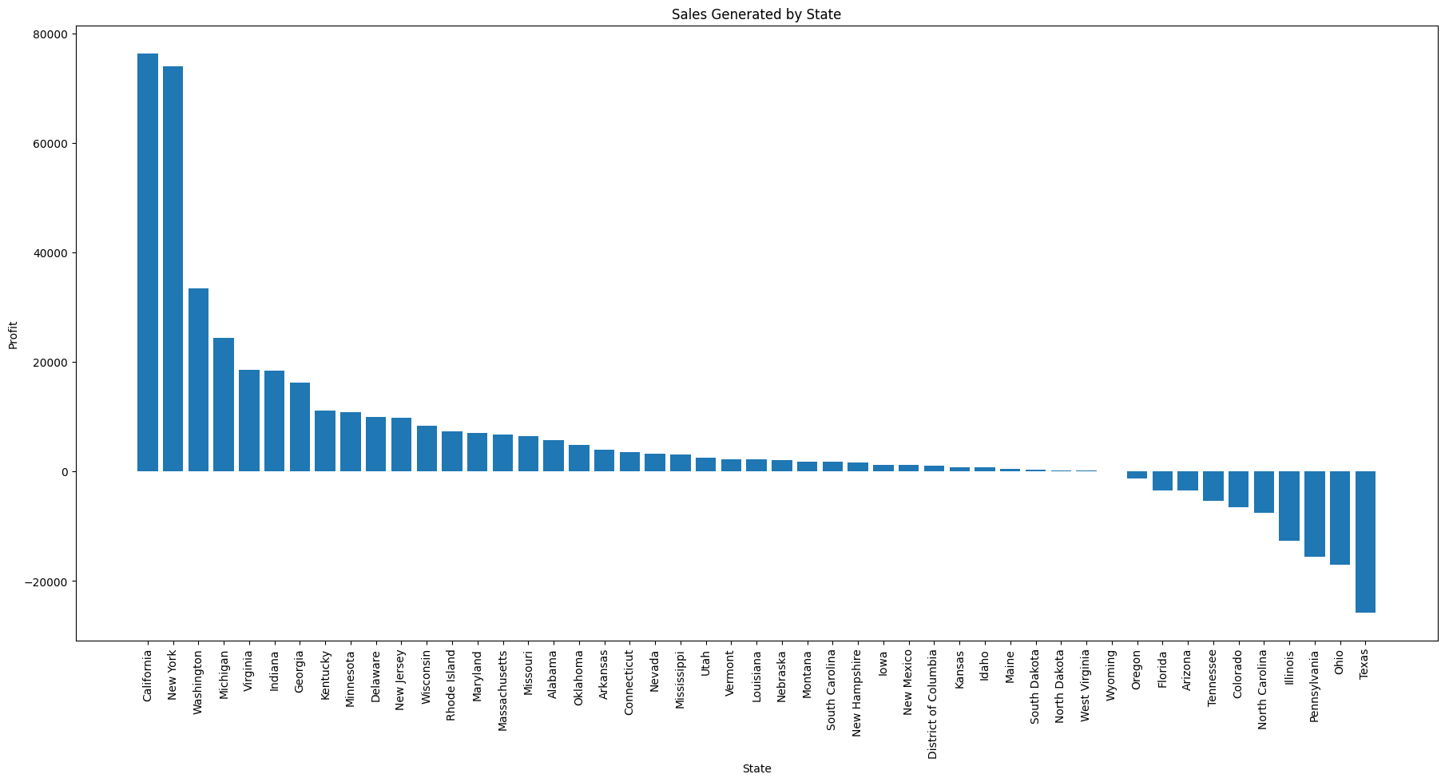
state_profit = df_places.groupby(['state'], as_index=false).sum() state_profit.sort_values(by='profit', ascending=false, inplace=true) plt.figure(figsize=(22,10)) plt.bar(state_profit['state'], state_profit['profit'], align='center',) plt.xlabel("state") plt.ylabel("profit") plt.title("sales generated by state") plt.xticks(rotation=90) plt.show() state_profit
The code groups the data by state, calculates the total profits for each state, sorts the results, and then creates a bar plot to visualize the profits generated by each state. The plot is labeled and displayed on the screen. The resulting DataFrame, ‘state_profit’, contains the summed profit values for each state.

Slide 30
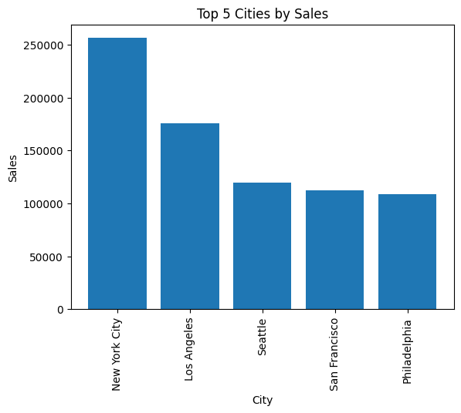
city_sales = df_places.groupby('city', as_index=false).sum() # sort the data by sales in descending order city_sales.sort_values(by='sales', ascending=false, inplace=true) # select the top 5 cities top_5_cities_sales = city_sales.head() plt.bar(top_5_cities_sales['city'], top_5_cities_sales['sales'], align='center') plt.xlabel("city") plt.ylabel("sales") plt.title("top 5 cities by sales") plt.xticks(rotation=90) plt.show() top_5_cities_sales
The code groups the data by city, calculates the total sales for each city, sorts the results, and selects the top 5 cities with the highest sales. It then creates a bar plot to visualize the sales for these top 5 cities. The plot is labeled and displayed on the screen. The resulting DataFrame, ‘top_5_cities_sales’, contains the top 5 cities and their corresponding sales values.

Slide 31
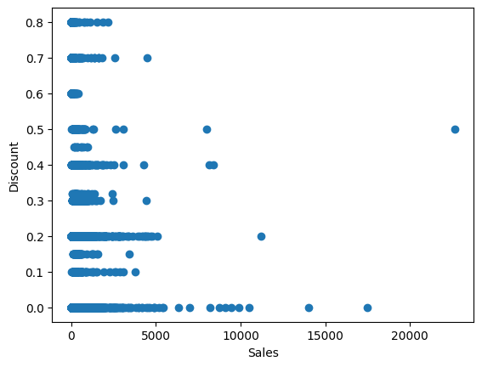
# create a scatter plot between sales and discounts plt.scatter(df['sales'],df['discount']) plt.ylabel("discount") plt.xlabel("sales") plt.show()
By visualizing the scatter plot, we can analyze the relationship between sales and discounts. Each point on the plot represents a specific data point, where the x-coordinate represents the sales amount and the y-coordinate represents the discount given for that sale. The scatter plot allows us to observe if there is any correlation or pattern between the two variables. For example, we can determine if higher discounts are associated with higher sales or if there are any outliers or clusters of data points.

Slide 32
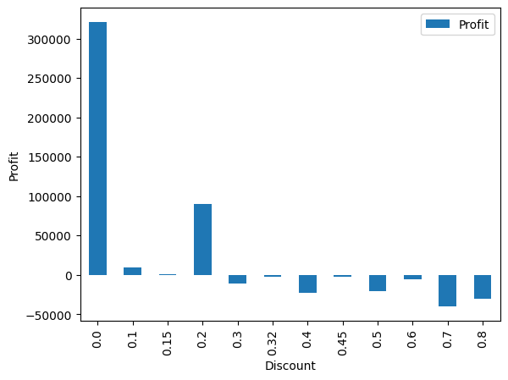
# group the data by the discount and compute the average sales discount_group = df.groupby(["discount"]).sum()[["profit"]] ax = discount_group.plot(kind="bar") ax.set_ylabel("profit") plt.show()
By visualizing the bar plot, we can compare the average profits for different discount levels. The plot allows us to identify which discount level is associated with higher profits and which might be less effective in generating profits. It provides a clear visual representation of the relationship between discounts and profits, helping us make informed decisions about pricing strategies or discount offers.

Slide 33
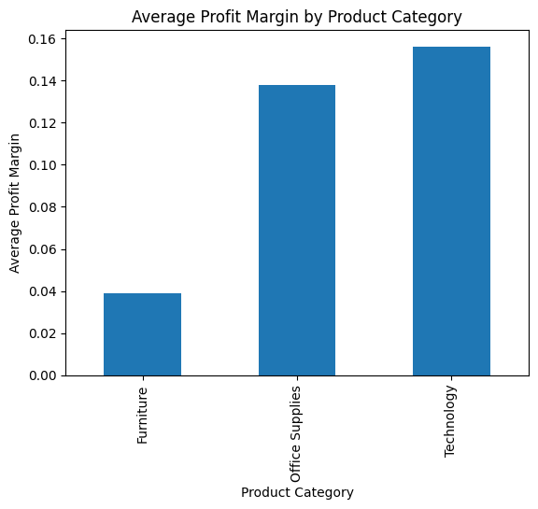
df['profit margin'] = df['profit'] / df['sales'] # group the data by product category and calculate the average profit margin for each category avg_profit_margin_by_category = df.groupby('category')['profit margin'].mean() # plot the average profit margin for each category as a bar chart avg_profit_margin_by_category.plot(kind='bar') # add a title and labels to the chart plt.title("average profit margin by product category") plt.xlabel("product category") plt.ylabel("average profit margin") plt.show()
By visualizing the bar chart, we can compare the average profit margin across different product categories. This allows us to identify which categories have higher or lower profit margins, providing insights into the profitability of different product lines. The chart helps us make informed decisions about resource allocation, pricing strategies, or potential improvements in specific product categories.

Slide 34
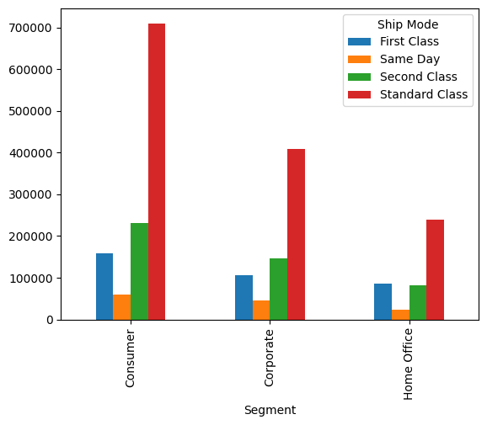
# plot the pivot table as a bar chart pivot_table.plot(kind='bar', stacked=false) plt.show()
By visualizing the pivot table data as a bar chart, we can gain insights into the relationships between different variables and compare their values across different categories. This visualization helps in identifying patterns, trends, and relative magnitudes of the data in a concise and easily understandable manner.

Slide 35
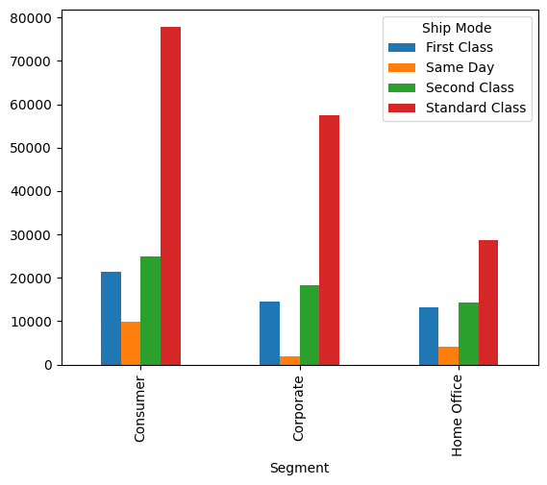
#profit pivot_table = df.pivot_table(index='segment', columns='ship mode', values='profit', aggfunc='sum') pivot_table.plot(kind='bar', stacked=false) # show the plot plt.show()
By visualizing the pivot table data as a bar chart, we can compare the profits for different segment and ship mode combinations. This allows us to identify which combinations are more profitable and gain insights into the performance of different segments and ship modes in terms of generating profits. The chart helps in making data-driven decisions regarding segment-specific strategies or optimizing shipping methods for maximizing profits.

Slide 36
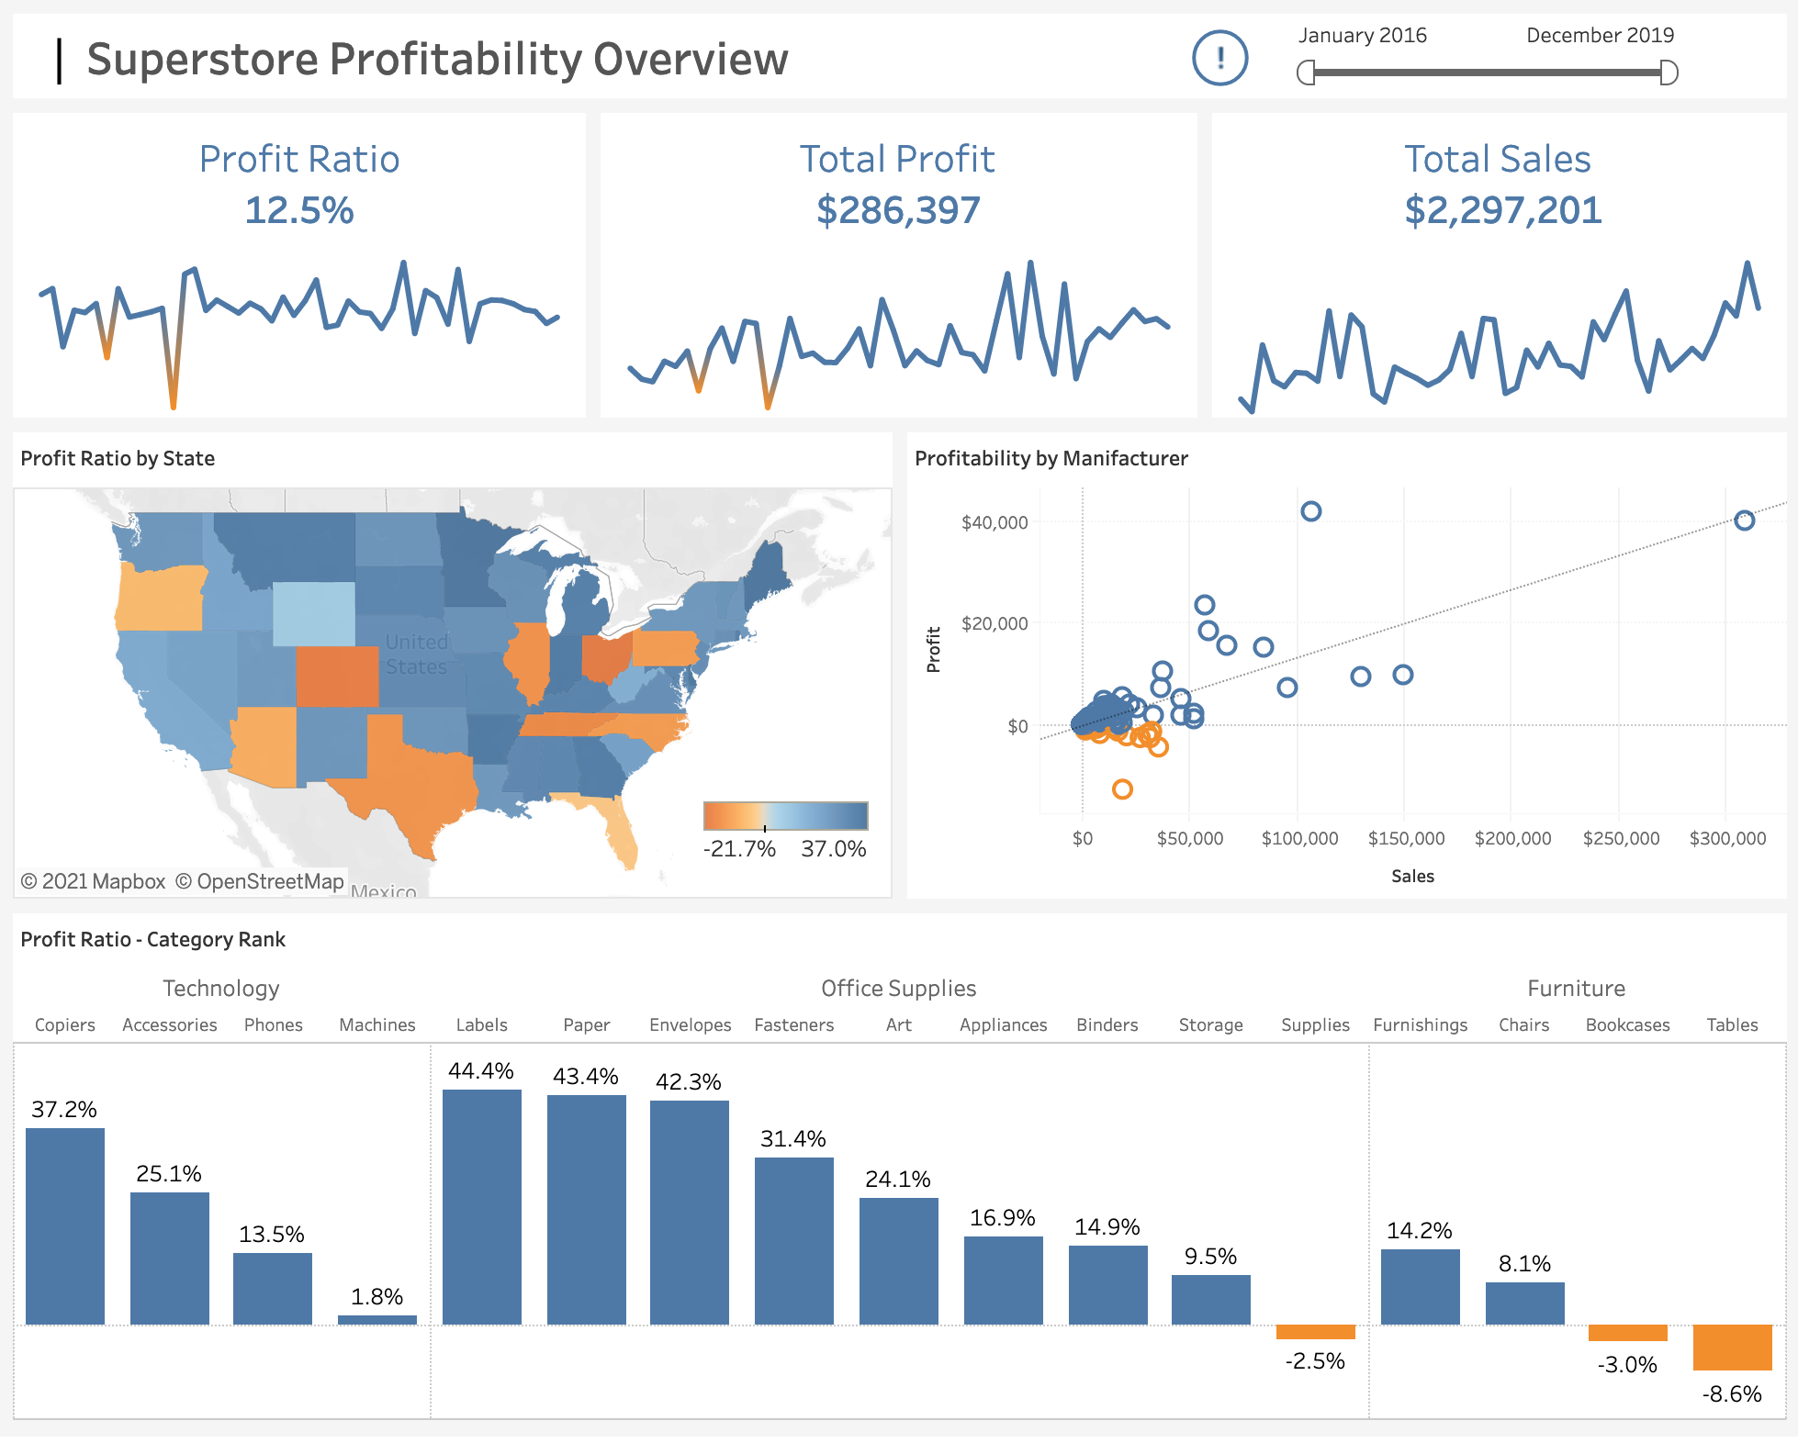
RESULTS

Slide 37
CONCLUSION
The conclusion of a Superstore analysis dataset will depend on the specific insights and patterns observed during the analysis. However, here are some possible conclusions that could be drawn from analyzing the Superstore dataset:
Sales and Profits
Customer Segments
Product Performance
Pricing and Discounts
Supply Chain and Logistics
Customer Satisfaction
Seasonal Trends

